Slide 1
Sorority and Fraternity Management System
Jennifer Barry
Meredith Weiner
Advisor: Professor Femister

Slide 2
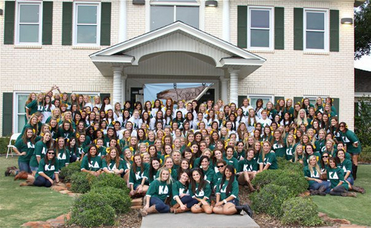
Client

Slide 3
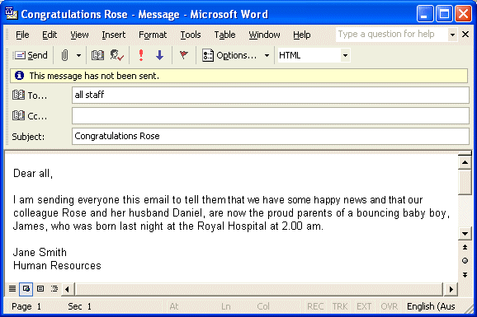
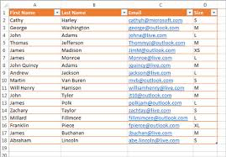
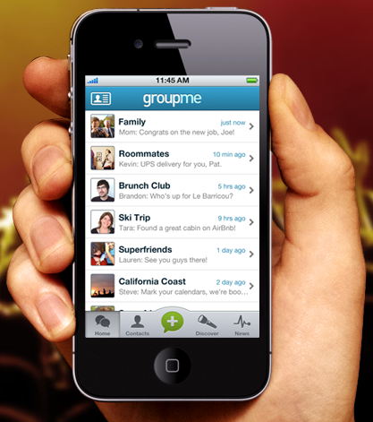
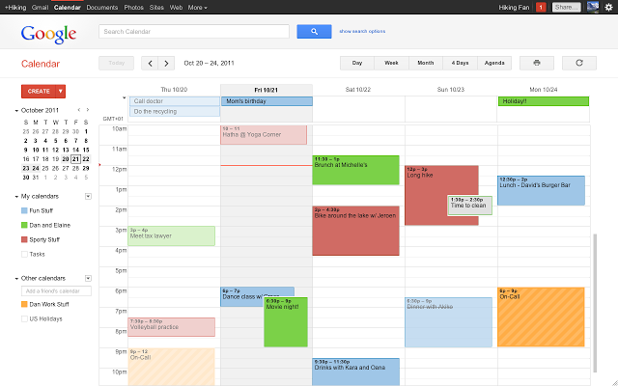
Problem

Slide 4





Our solution

Slide 5
Customer Requirements
Phase 1
Each chapter can subscribe to this service
Roster with contact information and positions
Profile page for each member
Role based access rights
Event information and sign up system
Phase 2
Links to each social media site
Menu for the week, as per the chef
Keeping track of event attendance based on sign-ups

Slide 6
Implementation
Platform Phases
Phase 1: run application on a desktop web browser
Phase 2: run application on a mobile web browser
Phase 3: run application as a native app using Phonegap (using data)
Technologies to be used
HTML, CSS, JavaScript, Bootstrap

